Slide 1


Enterprise Architecture
Office of Administration
Office of Information Technology,
Bureau of Enterprise Architecture

Slide 2
Office of Information Technology
Mission Statement
“To serve the Commonwealth of Pennsylvania and its citizens by providing enterprise-wide technology policy, standards, architecture, information, and solutions to enhance system interoperability, security and cost effectiveness.”
Enterprise Architecture is a guiding principle for the Office of Information Technology’s new organization. This approach provides alignment with Federal Government directives and mandates to ensure compliancy among each agency and the Commonwealth enterprise resources.

Slide 3
Enterprise Architecture Guiding Principles
Support the vision of standards of excellence in IT governance
Address the challenge to create more efficiency with less cost
Partner in the development of business and technology standards, policies and solutions for Commonwealth Enterprise resources.
Establish a collaborative Enterprise Governance model that leverages our existing resources and knowledge expertise in a team-oriented approach designed to structure standards development through evaluation, measurement and alignment with our business needs and drivers.
Align enterprise architecture governance with Communities of Practice, Enterprise Projects, Services and Solutions, Operational Support, GIS and special projects/initiatives.

Slide 4
Business Planning
Business, Strategic and Budgetary Planning
Communities of Practice
Agencies
Business Architecture
► Business Process Identification and Mapping ► Business Intelligence
► Communities of Practice ► Policy Review and Creation
► Project Management Methodologies ► Performance Measurement
OIT & Agencies
Information Architecture
Agency Profile Database and IT Portfolios
► Business Intelligence ► Knowledge Management and Transfer
► Workflow and Document Management ► Classifying data, meta-data, ISAC
► Enterprise Reporting ► Asset Management
Enterprise Architecture Framework
Enterprise Architecture Framework
Application Architecture
► Code Registry & Re-use – Component Driven ► Application Integration
► Project Development Frameworks and Best Practices ► IT Principles and Tech Trends
► Training Standardization ► Modeling and Simulation
Infrastructure Architecture
► Network & Communications ► Client/Server & Web Technologies
► Computing and Storage Standards ► Services & Support
OIT &
Agencies

Slide 5
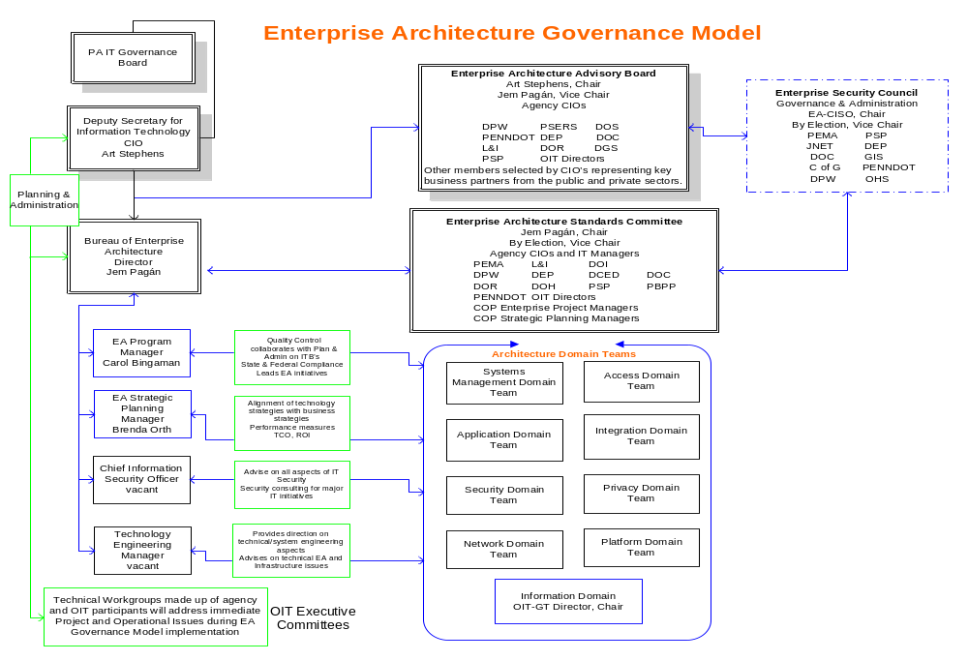

Slide 6
Enterprise Architecture Advisory Board
EAAB Participants
Provides strategic leadership and direction for information technology investments and standards
Guide the establishment of IT standards and policies on behalf of the enterprise
Focus on business requirements from the Enterprise perspective
Ensure business requirements drive all technology decisions
Meets bi-monthly
Key Skills:
Leadership
Focus on the Enterprise
Collaborative
Objective

Slide 7
Enterprise Architecture Standards Committee
EASC Participants
Guide the development of IT standards and policies on behalf of the enterprise
Focus on business requirements from an enterprise, not just a single agency perspective
Ensure that business requirements drive all technology decisions
Make decisions based on recommendations submitted by the Domain Teams
Meets monthly
Key Skills:
Technology Leader
Enterprise view
Collaborative
Objective

Slide 8
EA Domain Participant Profiles
Domain Team Participants
Provide subject matter expertise to one or more of the EA Domains
Gather, analyze and finalize Commonwealth business requirements
Provide recommendations on the development of IT standards and policies
Develop technology solutions and submit for review to the EA Standards Committee
Focus on technology issues from an enterprise, not just a single agency perspective
Understand that business requirements drive all technology decisions
Develop solutions that:
  Fulfill business requirements
  Leverage existing technology
  Adhere to all standards and policy
Key Skills
Technology expertise in a domain area (s)
Enterprise view
Collaborative
Objective

Slide 9
Enterprise Architecture
Process Overview
The EASC will develop the project charter for all projects assigned to domain teams or technical work groups that will identify:
  Business objectives and business drivers
  Guiding principles
  Existing ITB’s that may be impacted or new ITB’s that are needed
  Success criteria
  Timeline for completion
The domain team or technical work group will:
  Gather enterprise and agency requirements for analysis
  Solicit executive feedback where exceptions or gaps exist
  Determine if there are existing solutions that can be leveraged
  Review best practice and industry analysis reports
  Engage business partners to obtain additional information where appropriate

Slide 10
Enterprise Architecture
Process Overview
The domain team or technical work group will:
  Develop technology solutions and/or options including:
    Cost benefit analysis, total cost of ownership and ROI analysis
  Complete performance measurement plan and establish enterprise scorecard
  Develop best practice policies and procedures to support draft ITB’s
  Develop content for the ITB and submit to EA and then EASC for review and feedback
  (EASC submits to EAAB for review and feedback)

Slide 11
Enterprise Architecture Domains and Disciplines
The following slides will provide a brief description of the disciplines within the 9 domains that will be part of the Enterprise Architecture and includes examples of typical projects within that domain. These domains are:
  Access
  Information
  Application
  Integration
  Network
  Platform
  Systems Management
  Privacy
  Security

Slide 12
Enterprise Architecture Domains and Disciplines
Access Domain
Access - electronic delivery of information and services; includes internet, intranet,
and extranet access.
Branding - defines the "look and feel" for government Web sites.
Accessibility - applies to tool sets used to facilitate the accessing of information
and services by disabled citizens
Examples: Policies governing internet access to applications, standards for
deploying technology that can be utilized by disabled citizens or employees, Anti Spam
Information Domain
Data Management - data definition, design, management and administration of data
Knowledge Management - systematic process of finding, selecting, organizing and
distilling information (Examples include Document Management, Data Warehousing,
Data-marts, and Metadata).
GIS - defines the standards and technologies for implementation of Geographic
Information Systems.
Data Storage - acquisition and deployment of data storage media
Examples: Database standards, selection of Business Intelligence software, GIS
Mapping and Imaging Repositories

Slide 13
Enterprise Architecture Domains and Disciplines
Application Domain
Application Development Management - technologies that define how applications
are designed, documented, and maintained; technologies that optimize the use and
reuse of application components; strategies for the retention/phase out of legacy
applications.
Electronic Collaboration – tools that facilitate the interaction of the workforce and
promote group productivity. These include e-mail, directory services and other
person-to-person or group collaboration tools.
Examples: Active Directory Upgrade (2003), MVSJVM Extraction, DSF Assessment
Project, selection of new application development tools
Integration Domain
Functional Integration - responsible for the conceptual and logical models which
show how each of the functional areas, various application systems, and
business information requirements tie together.
Middleware - the components that create an integration environment between
the user workstations and legacy and server environments, provides interfaces
between applications and network communications mechanisms.
Examples: Standards for middleware or broker software, SURE/JNET/CLEAN integration

Slide 14
Enterprise Architecture Domains and Disciplines
Network Domain
Physical Network - includes network infrastructure for the computing environment,
consists of infrastructure elements, physical components and protocols. It does
not include user workstations, server platforms, or their operating systems.
Network Management – management of the communications infrastructure for the
organization’s distributed computing environment. It defines the structure,
topologies, bandwidth management, carrier services and protocols, includes consideration
for public access from private and kiosk workstations, wireless devices and PCs
Examples: Telecommunications RFP, Operation Secure Enterprise
Platform Domain
Platform - decision-making criteria for the acquisition and deployment of computing
and data storage hardware, components of the Platform discipline range from
enterprise class servers to workstations and hand held computing devices.
Configuration Management - criteria for the set-up and provisioning of computing
and data storage hardware specifications and its operating software and systems,
provides for the inclusion of industry standard operating systems and utility
systems running on the platforms.
Examples: Application hosting policy

Slide 15
Enterprise Architecture Domains and Disciplines
Systems Management Domain
Asset Management - systems required for the tracking and reporting of assets
owned, service level agreements, capacity management, cost management and
personnel skills inventory.
Change Management - version control of all IT assets.
Console/Event Management - monitoring and controlling components of all
collective hardware and software within the data center.
Help Desk / Problem Management - monitoring and controlling problem reporting
and resolution.
Business Continuity - disaster recovery and restoring the enterprise to full
functionality.
Examples: Alternate Site Design and Planning

Slide 16
Enterprise Architecture Domains and Disciplines
Privacy Domain
Profiling - tools used for creating, maintaining, and utilization of profiles for the
various stakeholders of the organization’s services.
Personalization - tools used for creating, maintaining and implementing
personalization of services and information.
Privacy - addresses the privacy concerns of citizens and agencies, addresses all
state and federal laws related to privacy issues.
Examples: Compliance to HIPAA, CHRII, IRS regulations
Security Domain
Enterprise Security – provides for audits and business process reviews for
monitoring and ensuring the security across the organization’s enterprise.
Includes securing the physical assets from theft and vandalism.
Network Security - monitoring and ensuring the security across the
organization’s network.
Host Security - monitoring and ensuring the security across the organization’s
platform infrastructure.
Examples: Operation Secure Enterprise, Identity Management/PKI, Enterprise Security
Assessment

Slide 17
Enterprise Architecture
2004 Planned Projects and Initiatives
Enterprise Architecture
Operation Secure Enterprise
Identity Management/PKI
Telecommunications RFP
DSF Assessment Project
Business Solutions Center of Excellence
Application Hosting Policy
Alternate Site Design and Planning
GIS Mapping & Imaging Repositories
Active Directory Upgrade (2003)
SURE/JNET/CLEAN Integration
MS Java Virtual Machine (MSJVM) Extraction
Enterprise Security Assessment

Slide 18
Highlight of Current Enterprise Architecture Projects
Operation Secure Enterprise
Security will be monitored and audited from an enterprise perspective - from the desktop, through the network, to the application servers which includes all physically connected devices to the Commonwealth enterprise.
The outcomes of the project include:
  Enterprise identity management design and framework
  Security assessment of the enterprise infrastructure, applications and systems
  Enterprise monitoring (real-time), auditing, and emergency intervention
  Performance measurements to address bandwidth and enterprise resource availability
  Acceptable use policies to manage administration of Commonwealth information assets
  Security best practices, procedures and certifications
  Security awareness programs focusing on physical and information security standards and practices for all Commonwealth employees

Slide 19
Highlight of Current Enterprise Architecture Projects
Enterprise Architecture
Establish an enterprise architecture governance structure
Invite Agency participation at all levels
Establish enterprise standards across all domains within 18 months
Identity Management
Create a comprehensive management solution that:
  Facilitates account provisioning/de-provisioning
  Synchronizes Active Directory and other identity directories across platforms/environments
  Supports single sign-on, an enterprise PKI solution and 2-factor authentication
DSF Assessment Project
Review of DSF functionality, including ability to meet future business requirements
Collect and analyze business requirements for future web services and an Enterprise Portal
Evaluate various portal technologies

Slide 20
Highlight of Current Enterprise Architecture Projects
Business Solutions Center of Excellence
Provide a service-oriented architecture framework for J2EE and .NET development environments
Develop a strategy and roadmap for future web services technology adoption
Development of processes and procedures for operating within that environment and for creating a strong framework and best practice recommendations for developing within each of the technologies.
Assist agencies with solutions for retraining of IT staff in newer technologies
Help OIT and agencies experiment with and prove emerging technologies
Develop other competencies to support code reuse, use of component based applications

